Slide 1
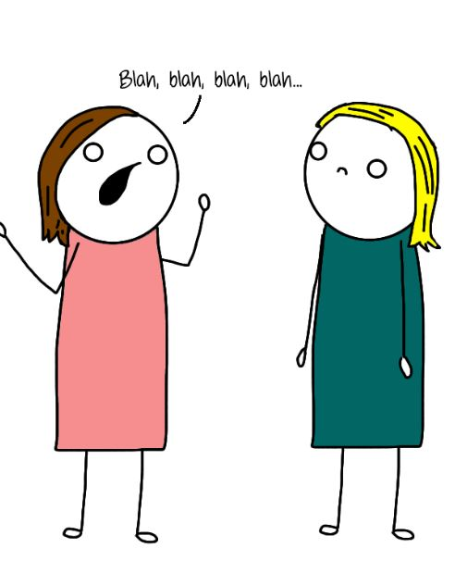
Natural Language & Documentation
Ana Rita Silva & Manuel Zamith
ERMS
12 Oct. 2016

Slide 2

“ Requirements are the project team’s to-do list. “

Slide 3
Characteristics of Good Requirements
Verifiable
The system must be user friendly.
The user interface shall be menu driven. It shall provide dialog boxes (...) for user inputs.
Clear & Concise
Sometimes the user will enter Airport Code, which the system will understand, but sometimes the closest city may replace it, so the user does not need to know what the airport code is, and it will still be understood by the system.
The system shall identify the airport based on either an Airport Code or a City Name.
Complete
On loss of power, the battery backup must support normal operations.
On loss of power, the battery backup must support normal operations for 20 minutes.

Slide 4
Characteristics of Good Requirements
Consistent
REQ1: Dates shall be displayed in the mm/dd/yyyy format. REQ2-Dates shall be displayed in the dd/mm/yyyy format.
Traceable
REQ1: The system must generate a batch end report and a discrepancy report when a batch is aborted.
REQ1.1: The system must generate a batch end report when a batch is aborted.
REQ1: For users in the U.S., dates shall be displayed in the mm/dd/yyyy format.
REQ2: For users in France, dates shall be displayed in the dd/mm/yyyy format.
This can eventually lead to the following requirement: “REQ3: Dates shall be displayed based on the format defined in the user’s web browser.”
REQ1.2: The system must generate a discrepancy report when a batch is completed or aborted.

Slide 5
Characteristics of Good Requirements
Implementation free
After 3 unsuccesful attempts to log on, a JavaScript routine must run and lock the user out of the system.
After 3 unsuccesful attempts to log on, the user must be locked out of the system.
Unambiguous
The system shall not accept passwords longer than 15 characters. If the user enters more than 15 characters while choosing the password, an error message shall ask the user to correct it.
The system shall not accept passwords longer than 15 characters.

Slide 6
Characteristics of Good Requirements
Viable/Feasible
The replacement control system shall be installed with no disruption to production.
The replacement control system shall be installed causing no more than 2 days of production disruption.
Necessary
All requirements specified in the Vision document shall be implemented and tested.
The requirement that can be removed because it does not provide any new information.

Slide 7
Exercise: Good or Bad Requirement?
Social Network - Login Module:
The user should be able to sign in with social media accounts.
Alternatively, the user should be able to sign in using username, full name and password.
The user should be able to login within 2 seconds.
All the user information should be safe.
The user shall receive weekly updates about the platform on its e-mail account.
Name of the user shall be used for marketing purposes.

Slide 8
Exercise: Good or Bad Requirement?
The user should be able to sign in with social media accounts.
Alternatively, the user should be able to sign in using username, full name and password.
VAGUE
ON POINT

Slide 9
Exercise: Good or Bad Requirement?
The user shall receive weekly updates about the platform on its e-mail account.
All the user information should be safe.
INCONSISTENT
VAGUE

Slide 10
Exercise: Good or Bad Requirement?
The user should be able to login within 2 seconds.
Name of the user shall be used for marketing purposes.
ON POINT
AMBIGUOUS

Slide 11
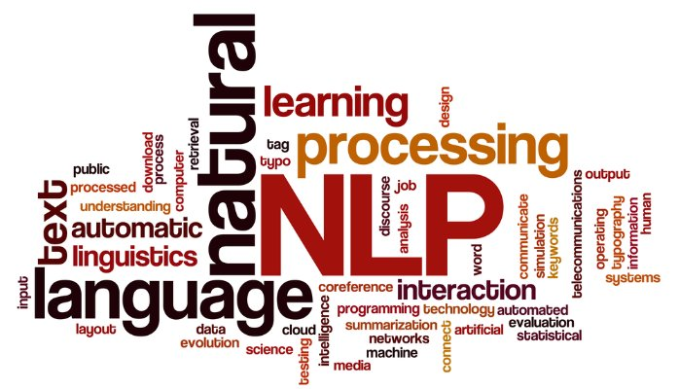
What is Natural Language?
It's simple human language, such as english, portuguese or french.
Differs from artificial languages such as programming languages.

Slide 12
Can be a direct tool for expressing and communicating requirements.
Several issues in requirement selection, validation, and conflict identification can be already tackled at this level.
Can be decoded by everybody.
Can be shared among the different people involved in the software development process.
Why is this useful?

Slide 13
Lack of clarity;
Difficult to read/hard to understand;
Confusion: functional/non-functional requirements, system goals and design information may not be clearly distinguished;
Amalgamation: different requirements may be expressed together;
Misunderstandings: ambiguity can be a huge problem;
Over-flexibility: the same thing can be expressed in a number of different ways;
There is no easy way to modularize natural language requirements!
Quid
Pro
Quos

Slide 14
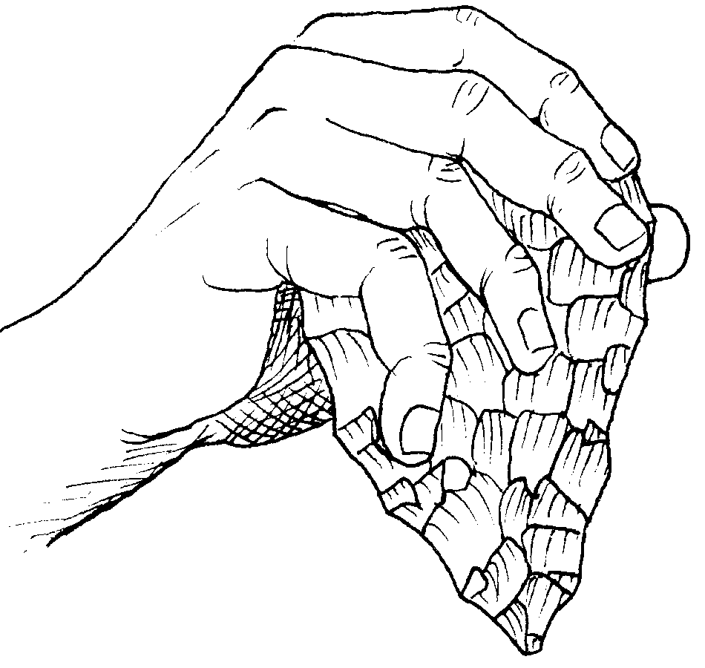
NLP Analysis
Tools

Slide 15
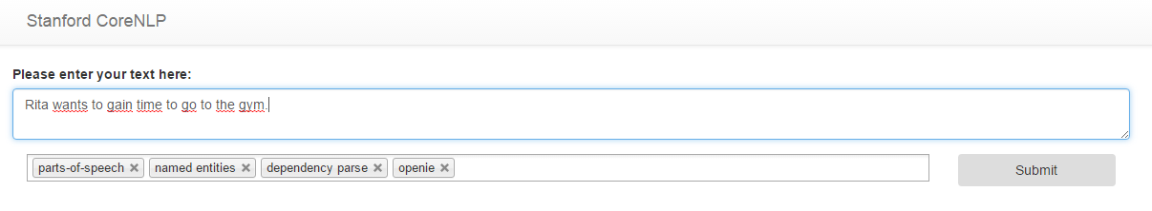
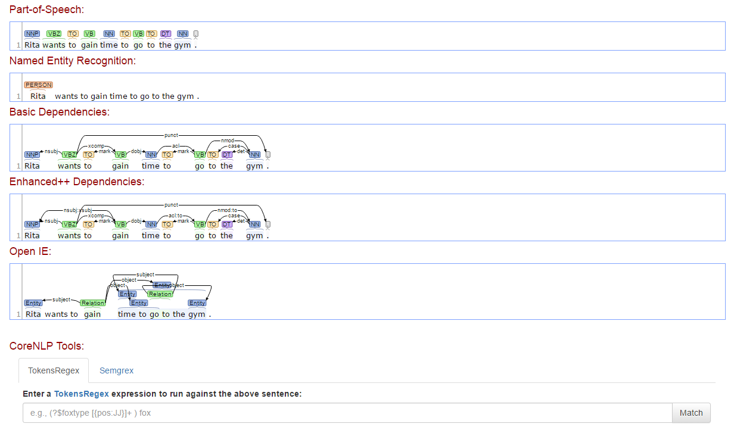
Stanford CoreNLP API
Integrated framework with a good range of grammatical analysis tools.
Fast, reliable analysis of arbitrary texts.
Support for a large number of languages.
Interfaces available for various major modern programming languages.
Ability to run as a simple web service.

Slide 16
Natural Language and Artificial Intelligence Platform
Offers a lot of possibly relevant information, like entity recognition using Wikipedia, DBPedia and Wikidata.

Slide 17
Leading platform for building Python programs to work with human language data.
Free, open-source, community driven project.

Slide 18
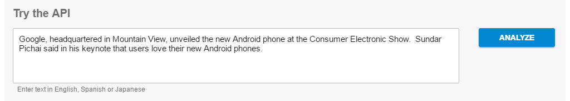
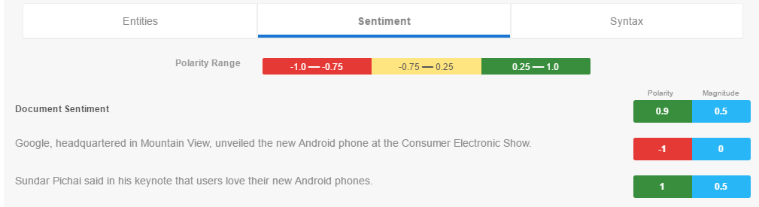
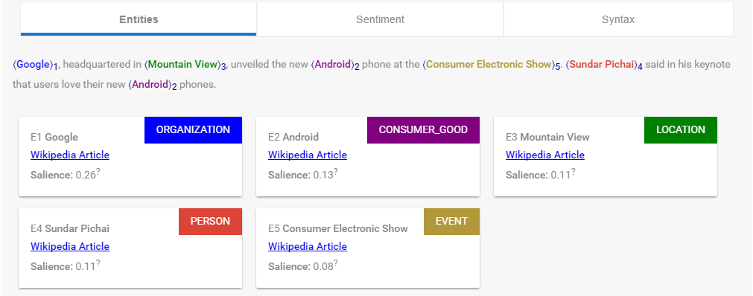
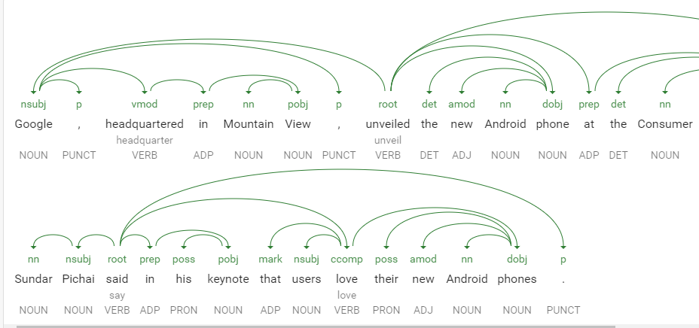
GOOGLE Cloud Natural Language API

Slide 19

ARM (Automated Requirements Measurement) by NASA
Tool to automatically analyze a requirements document and produce a detailed quality report.
Further enhanced to include additional functionality: custom definitions of quality indicators inputs for document analysis, e.g.
Report: based on statistical analysis of word frequencies at various structural levels of the document.
By 2011 work on the ARM tool was discontinued.

Slide 20
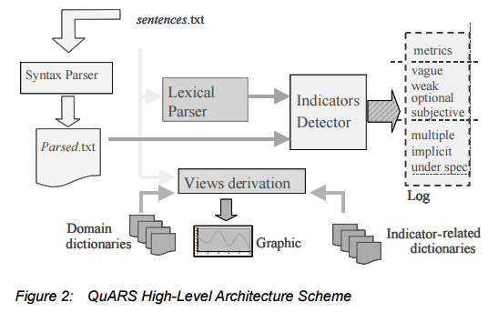
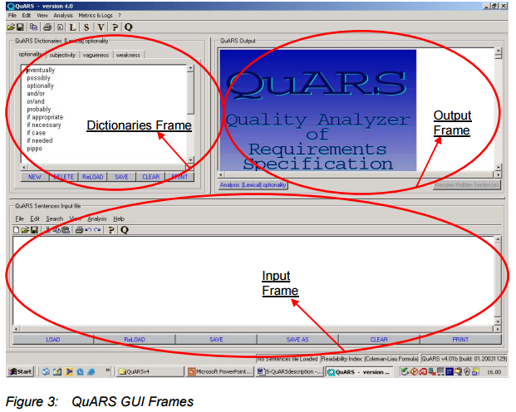
QuARS
Allows the extract of structured information and metrics -detecting linguistic inaccuracies and defects.
Allows an initial parsing of requirements by automatically detecting potential linguistic defects that can cause ambiguity problems at later stages of software product development.
Provides support for the consistency and completeness analysis of the requirements.

Slide 21

830-1998
IEEE Recommended Practice for Software Requirements Specifications

Slide 22
Functionality
External interfaces
Performance
Attributes
Design constraints imposed on an implementation:
What is the software supposed to do?
How does the software interact with people, the system’s hardware, other hardware, and other software?
What is the speed, availability, response time, recovery time of various software functions, etc.?
What are the portability, correctness, maintainability, security, etc. considerations?
Resource limits, operating environment(s) etc.?

Slide 23
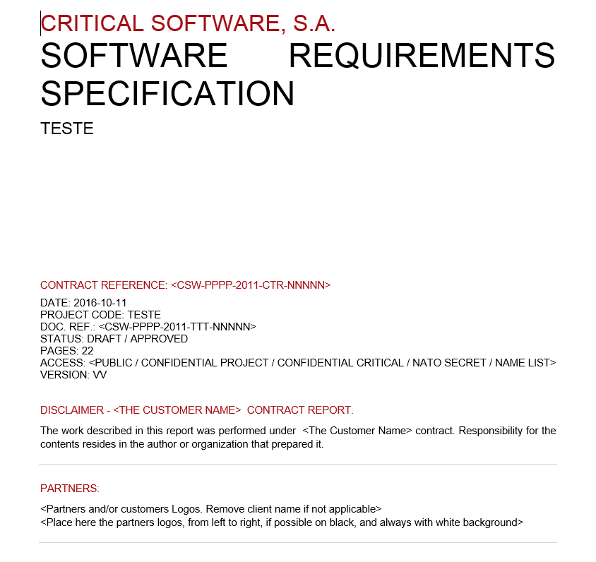
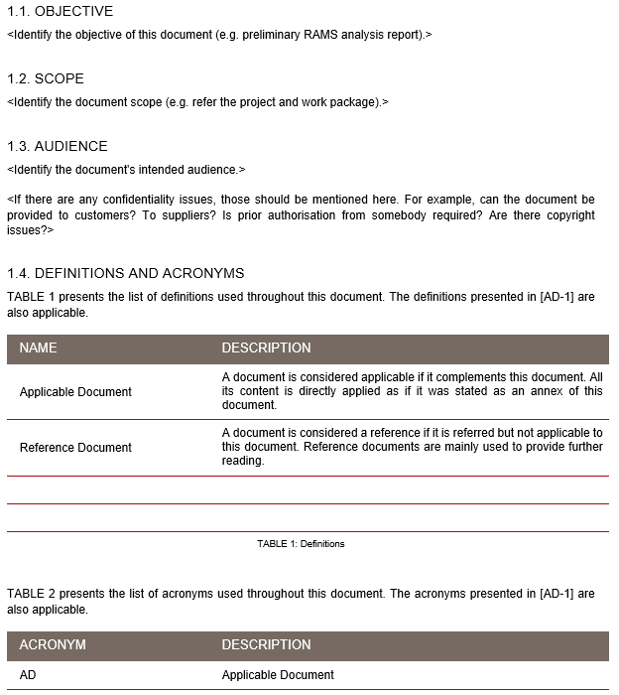
CSW Documentation Example
Generated through “MasterTemplate”
Introduction

Slide 24
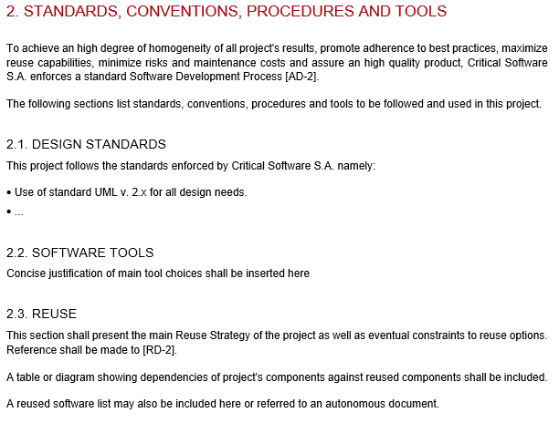
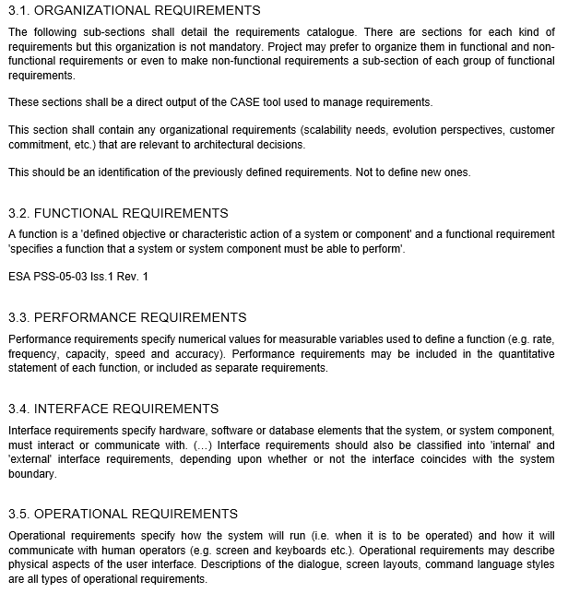
CSW Documentation Example
Standards, Conventions, Procedures and Tools
Requirements Catalogue

Slide 25
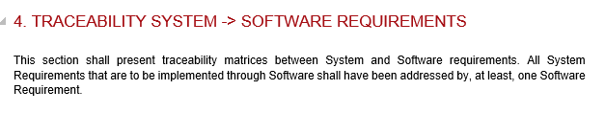
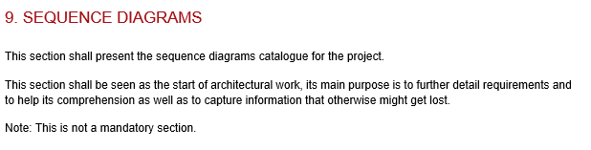
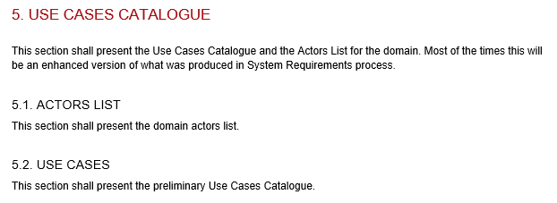
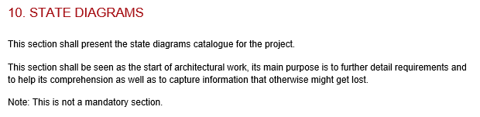
CSW Documentation Example
Traceability &
Use Cases Catalogue
Optional Diagrams

Slide 26

Practice Exercise
For every Specification Document that is generated, a Review process is made. This includes Requirements, as well as tests.
Imagine yourself as a reviewer!
Go through a requirement specification document and find as many flaws as you can. Flaws can be in the requirements themselves (ambiguous, inconsistent), or just because the document is not according to standard.
Use Word's comment functionality to leave your review. Never change the document directly. This way, the author can improve through a continuous feedback process.
The Requirements are about a simple search engine for Students of a University.
There are search inputs and a table that shows the results.

Slide 27
References
Ian Sommerville 2008, "Problems with natural language".
Ian Sommerville, “Software Engineering".
Vincenzo Ambriolaa and Vincenzo Gervasi, Dipartimento di Informatica, Università di Pisa, "Processing Natural Language Requirements".
"The NASA automated requirements measurement tool: A reconstruction", Article in Innovations in Systems and Software Engineering, 10(2):77-91 .

Slide 28
References (cont.)
Institute of Electrical and Electronics Engineers, Inc., 1998, “IEEE Recommended Practice for Software Requirements Specifications”.
Google Cloud Platform, “CLOUD NATURAL LANGUAGE”, available in: https://cloud.google.com/natural-language/
Giuseppe Lami, Stefania Gnesi and others, C.N.R, "An Automatic Tool for the Analysis of Natural Language Requirements".

Slide 29
THANK YOU!
IF YOU NEED ANY EXTRA HELP:
up201607821 & up201607826

